Slide 1



Hibernate Caching-Part 2
Chapter 42

Slide 2
Today’s Agenda
Hibernate Caching-Part 2
Second Level Cache
The Process Internally
Popular Implementations
Using EHCache

Slide 3
Second Level Cache
Second level cache was introduced in hibernate 3.0
The second level cache is responsible for caching objects across sessions.
When this is turned on, objects will be first searched in cache and if they are not found, a database query will be fired.

Slide 4
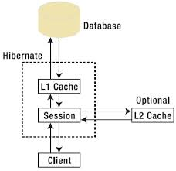
The Two Caches

Slide 5
How The Process Takes Place ?
When ever we load any object from the database, then hibernate , verifies whether that object is available in the local cache memory of that particular session (means first level cache )
If not available then hibernate , verifies whether the object is available in global cache or factory cache (second level cache )

Slide 6
How The Process Takes Place ?
If not available then hibernate will hit the database and load the object from there, and then it first stores the object in the local cache of the session ( first level ) then in the global cache (second level cache )
When another session needs to load the same object from the database, then hibernate copies that object from global cache (second level cache ) into the local cache of this new session

Slide 7
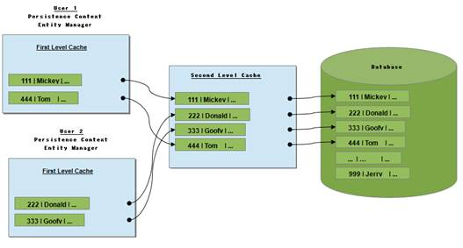
Second Level Cache

Slide 8
Implementations Of Second Level Cache
Different vendors have provided the implementation of Second Level Cache :
EH Cache
Swarm Cache
OS Cache
JBoss Cache

Slide 9
Using EHCache
To enable second level cache in hibernate following 3 changes are required
Add provider class in hibernate configuration file
<property name="hibernate.cache.region.factory_class">
org.hibernate.cache.ehcache.EhCacheRegionFactory
</property>

Slide 10
Using EHCache
Configure cache element for the class in hibernate mapping file
<cache usage="read-only" />
Create xml file called ehcache.xml

Slide 11
Cnfiguration File Entry
<property name="hibernate.cache.region.factory_class">
org.hibernate.cache.ehcache.EhCacheRegionFactory
</property>
<property name="hibernate.cache.use_second_level_cache">true</property>

Slide 12
Mapping File Entry
<hibernate-mapping>
<class name="in.scabhopal.hibernate.Employee" table='Employee'>
<cache usage="read-only" />
<id name="empNo" column="emp_no" >
</id>
<property name="empName" column="emp_name" />
<property name="empSal" column="emp_sal"/>
</class>
</hibernate-mapping>

Slide 13
ehcache.xml
<?xml version="1.0" encoding="UTF-8"?>
<ehcache>
<defaultCache
maxElementsInMemory="100"
eternal="false"
timeToIdleSeconds="120"
timeToLiveSeconds="200" />
<cache name="in.scabhopal.hibernate.Employee"
maxElementsInMemory="100"
eternal="false"
timeToIdleSeconds="30"
timeToLiveSeconds="50" />
</ehcache>

Slide 14
ehcache.xml
Session s1=sf.openSession();
Employee e=sess.get(Employee.class,2);
System.out.println("Loaded object employee name is___"+e.getEmpName());
System.out.println("Object Loaded successfully.....!!");
s1.close();
System.out.println("Session closed......!!!!!!!!");
Session s2 = sf.openSession();
Employee f=sess.get(Employee.class,2);
System.out.println("Loaded object employee name is___"+f.getEmpName());
System.out.println("Object loaded from global cache successfully.....!!");
s2.close();
sf.close();

Slide 15
Output
Hibernate:
select
employee0_.emp_no as emp_no1_0_0_,
employee0_.emp_name as emp_name2_0_0_,
employee0_.emp_sal as emp_sal3_0_0_
from
Employee employee0_
where
employee0_.emp_no=?
Loaded object employee name is___emp-2
Object Loaded successfully.....!!
Session closed......!!!!!!!!
Loaded object employee name is___emp-2
Object loaded from global cache successfully.....!!

Slide 16
Caching Strategies
Read Only: This caching strategy should be used for persistent objects that will always read but never updated.
It’s good for reading and caching application configuration and other static data that are never updated.
This is the simplest strategy with best performance because there is no overload to check if the object is updated in database or not.

Slide 17
Caching Strategies
Read Write: It’s good for persistent objects that can be updated by the hibernate application.
However if the data is updated either through backend or other applications, then there is no way hibernate will know about it and data might be stale.
So while using this strategy, make sure you are using Hibernate API for updating the data.

Slide 18
Caching Strategies
Nonrestricted Read Write: If the application only occasionally needs to update data and strict transaction isolation is not required, a nonstrict-read-write cache might be appropriate.

